Slide 1
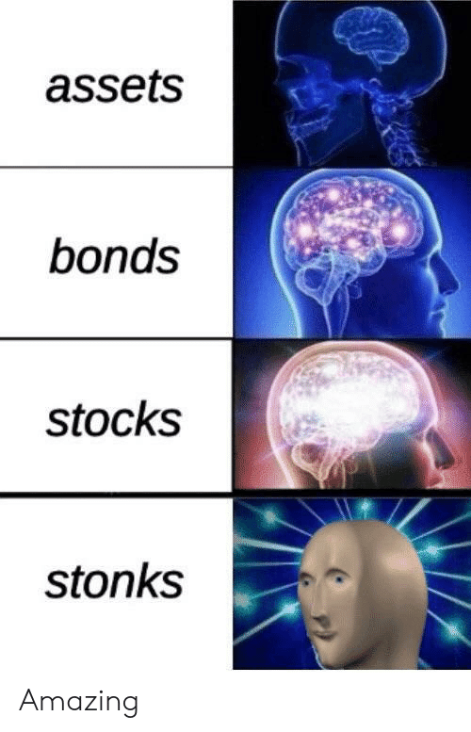
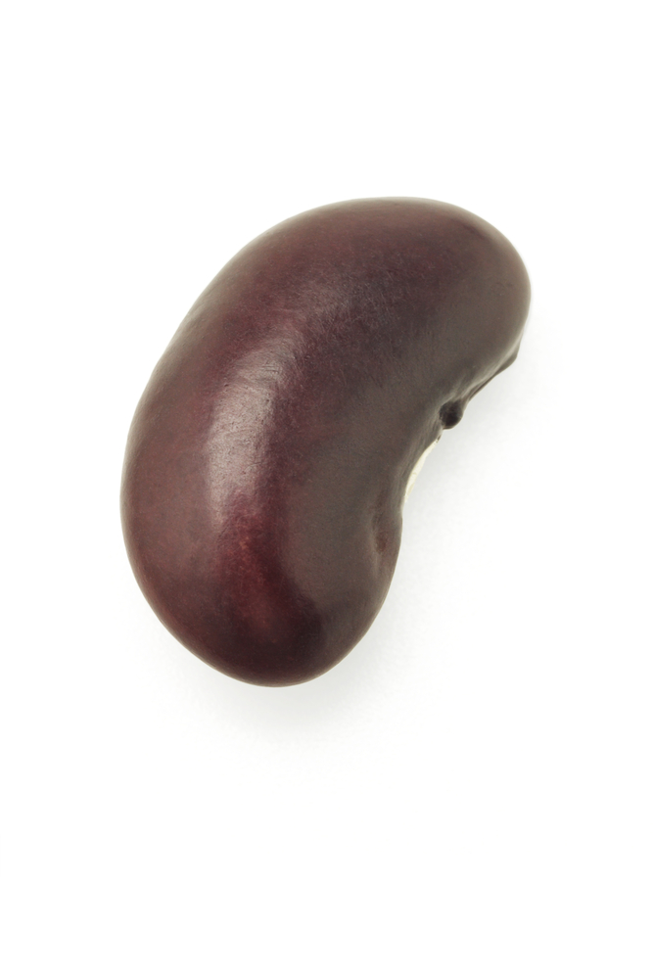


Day 1 – 4:00 Project Progress Report -Tympe-
Logan Schlick, Daniel Marin, Kyle Rimando, Sonny Pizzo, Shane Ghuste

Slide 2



Front end progress…
Completed basic skeleton of the website
Ability to link the back end with the front end
Next is to polish back end and fix viewing bug
Add game features
Front end designers:
Daniel Marin
Sonny Pizzo

Slide 3
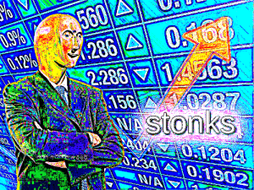
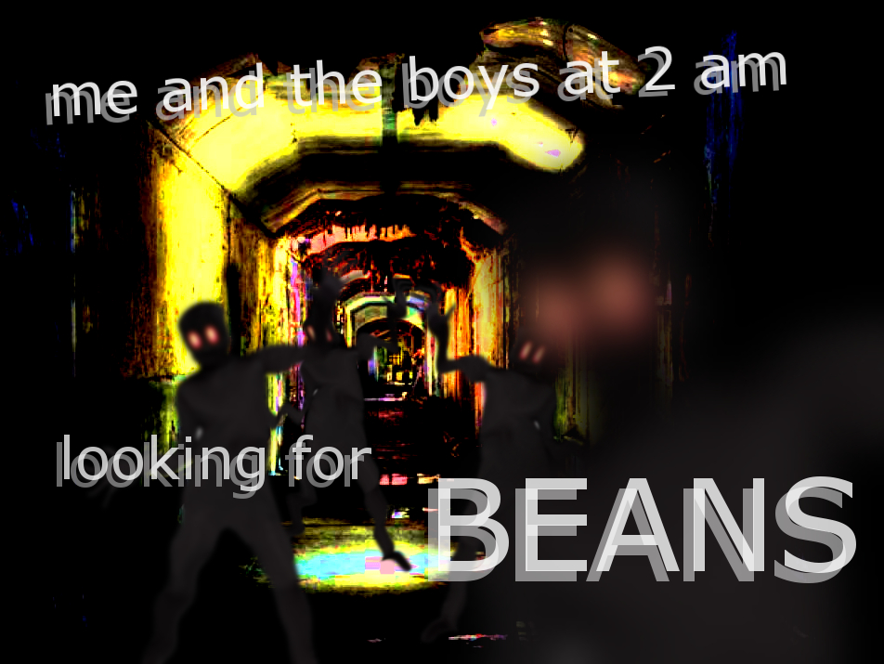

Back end progress…
Ability to generate a random word, and type it to move onto the next word
Move from welcome page to the start page
Next is to focus on being able to detect a wrong answer
Back end designers:
Logan Schlick
Kyle Rimando

